Slide 1
St. Louis Blight analysis
Timothy Goldman, Hasib Ibradzic, Heather Leek

Slide 2
Motivation and Summary
The motivation for the project was to understand if vacant buildings are an indicator of blight in a particular city or zip code. Per the Blight Authority definition, Urban blight is the process by which a previously functioning city, or part of a city falls into disrepair and decrepitude. The removal of blight is critical to the health, safety and welfare of a community.
Hypothesis: It is possible to predict which neighborhoods in St. Louis will fall into blight based upon an increase in vacant buildings?
Questions asked:
Are there economic indicators indicative of blight?
Do property values decline prior to blight?
Does the percentage of vacant properties increase in a community undergoing blight?
Does reinvestment in a community contribute to the lessening of blight?
Can you predict blight based upon an increase in vacant buildings?
Conclusion:
An increase in vacant buildings alone does not necessarily indicate blight.
Other variables may more profoundly predict a community going into blight.
Further testing of the hypothesis may include an analysis of crime rates, percentage of population below the poverty line or unemployment rates.

Slide 3
Questions and Data
A concentration of vacant properties can be an indicator of blight. We investigated potential data sources from the St. Louis City Open Data project to determine if there is evidence within the data that a concentration in vacant buildings results in a decline in property tax values.
The data utilized in the project came from the St. Louis City Open Data website (https://www.stlouis-mo.gov/data/) in an Access database format.
Two specific tables were utilized from the Access database including:
Parcel (PRCL)
Residential data (PRCLREAR)
Data was initially investigated for completeness within the Access database and consumed for cleaning and analysis through the use of a Jupyter Notebook.

Slide 4
Data Cleanup and Exploration
Application/software requirements:
Access
PANDAS
MATPLOTLIB
Jupyter Notebook
Detailed walk through of clean-up activities

Slide 5
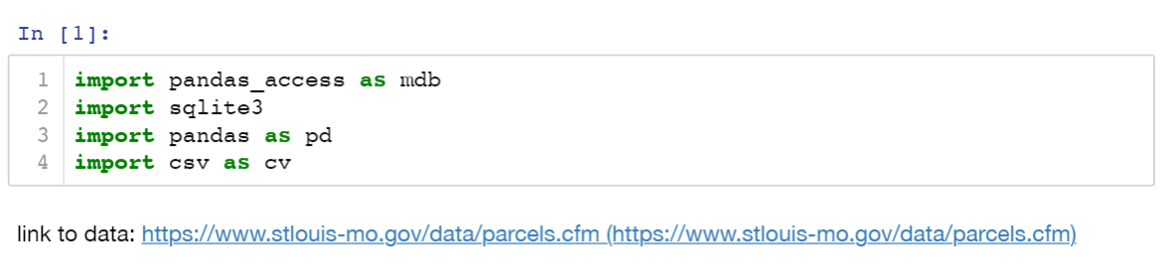
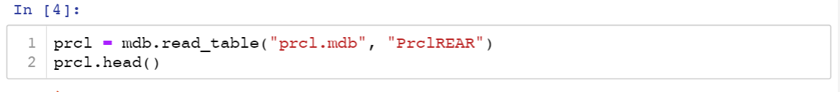
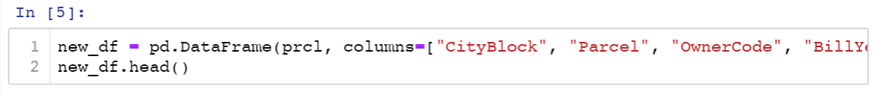
Data Clean-up Process

Slide 6
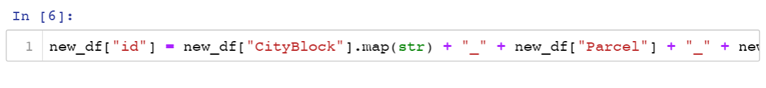
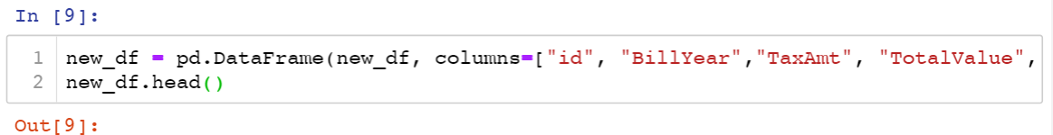
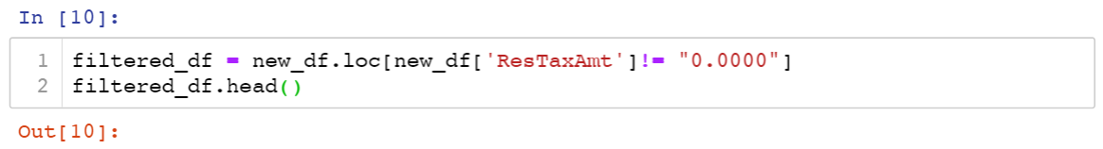
Data Clean-up Process

Slide 7
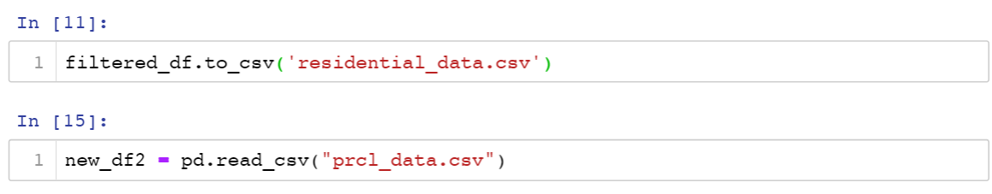
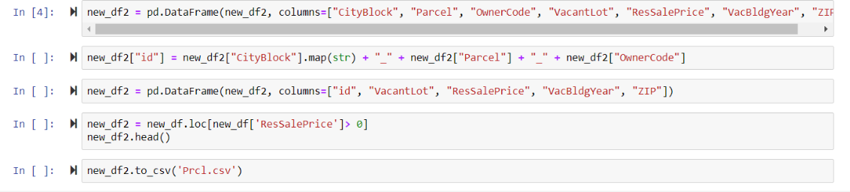
Data Clean-up Process

Slide 8
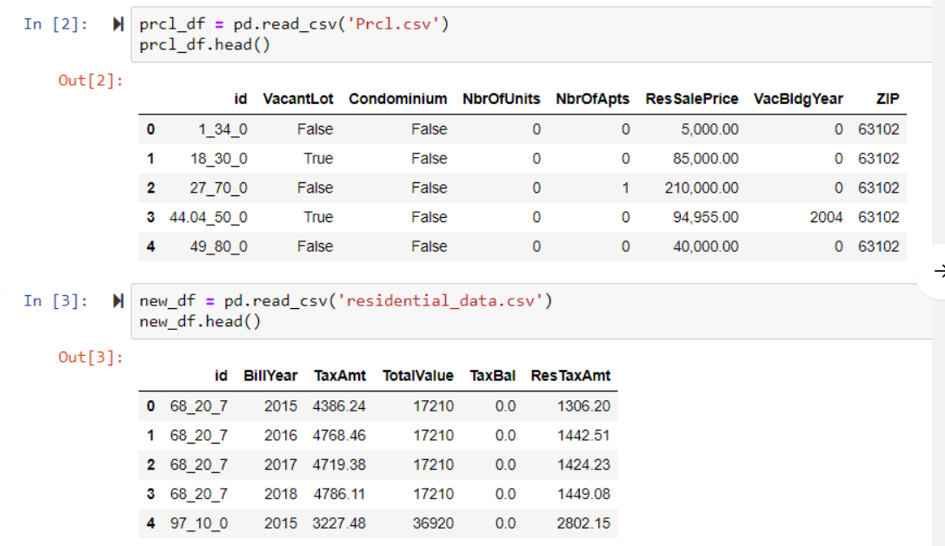
Data Analysis

Slide 9
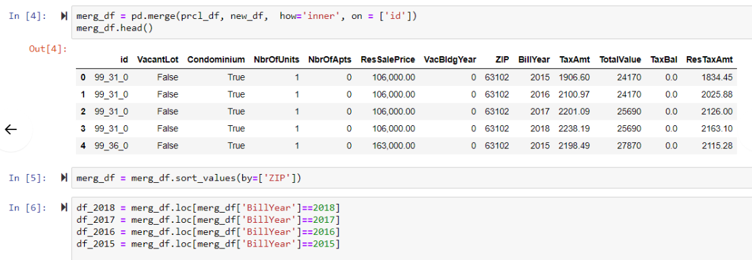
Data Analysis

Slide 10
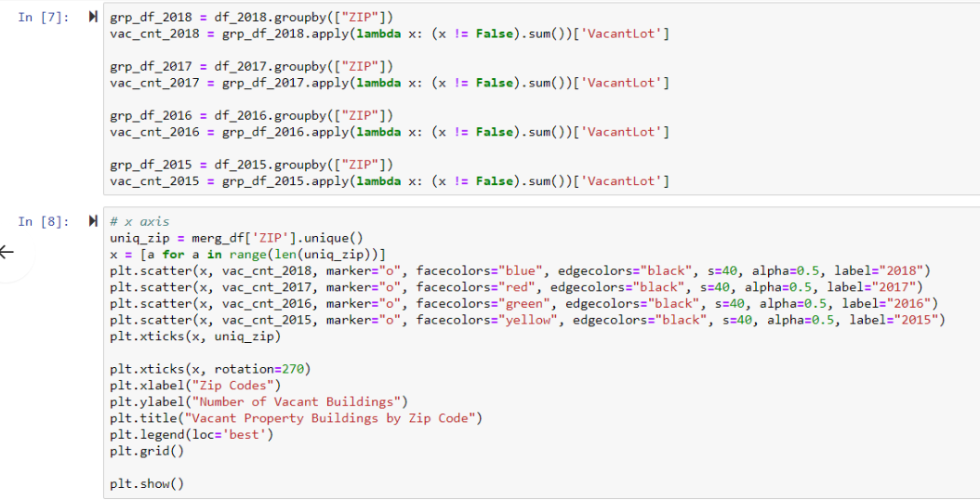
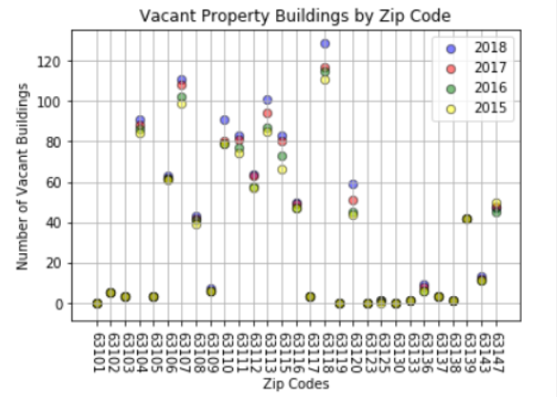
Data Analysis

Slide 11
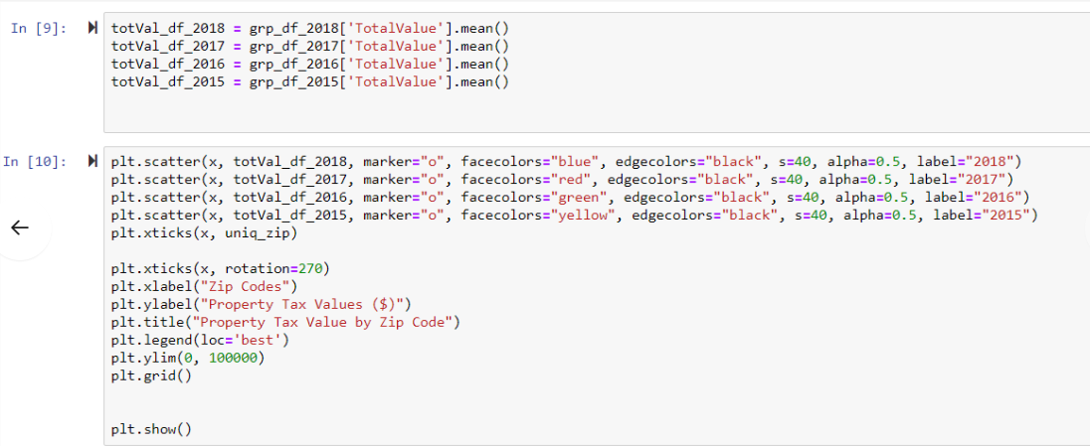
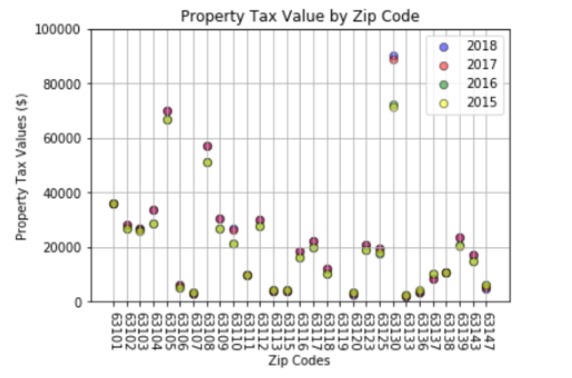
Data Analysis

Slide 12
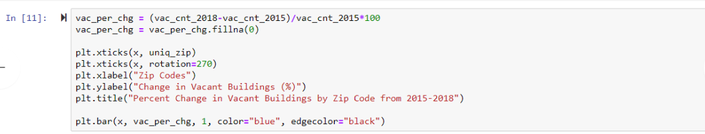
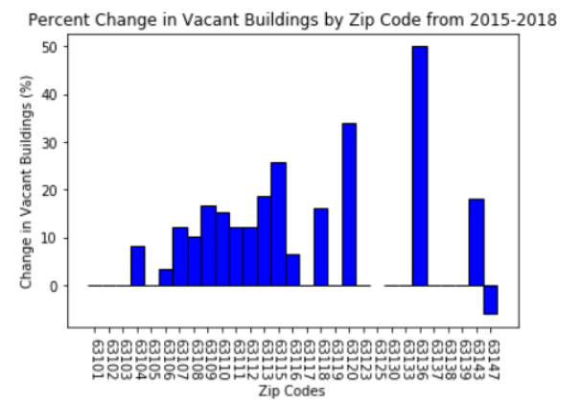
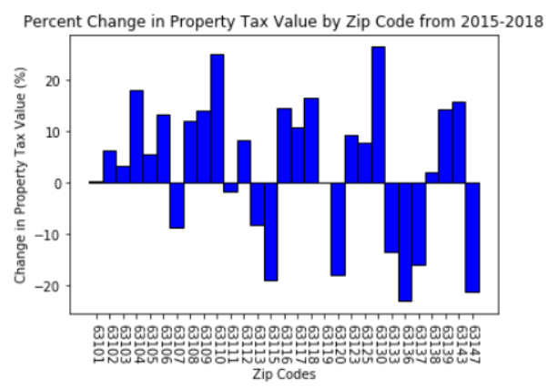
Data Analysis

Slide 13
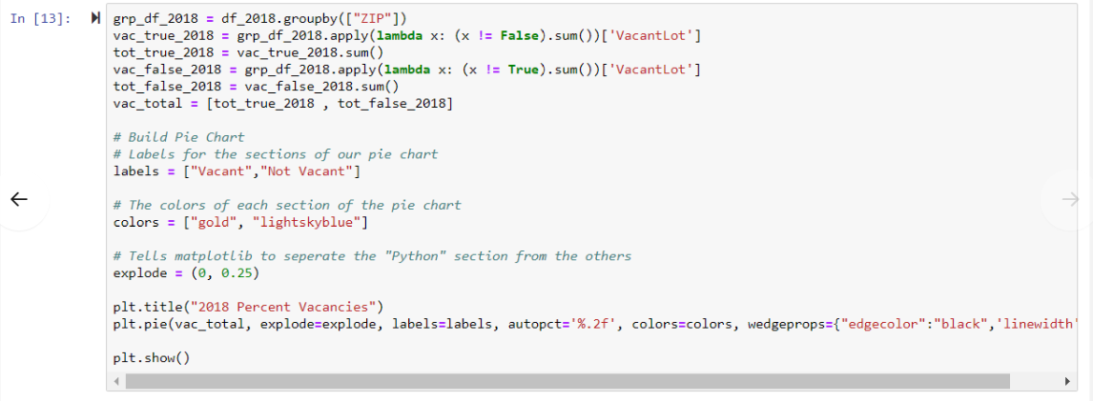
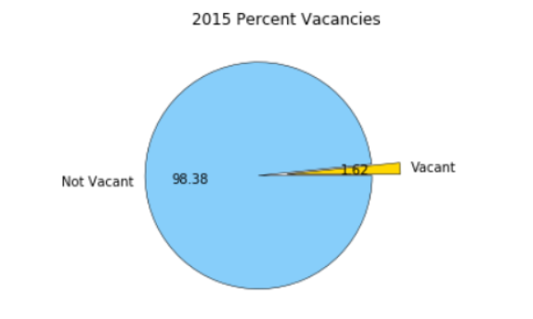
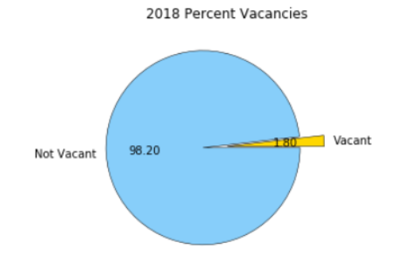
Data Analysis

Slide 14
Discussion
Our interpretation of the definition of blight is an increase in vacant buildings coupled with declining property values. There may be other interpretations of the definition that may find fault with our assumptions.
Based on our hypothesis, an increase in vacant buildings does not necessarily mean that a community will go into blight. Therefore, we must reject the null hypothesis.
As a team, we did not expect this finding. We expected to see declining property tax values spread across the years included in the study for zip codes that had increases in vacant buildings.
Many of the zip codes saw increases in property tax values when 2018 was compared to 2015.
The starting base for property tax value may be an indicator of blight as many of the zip codes have very low values.
Out of the top 5 zip codes with increases in vacant buildings, 3 of the 5 had increasing property tax values.
Additional variables would need to be considered to ultimately determine what the true indicators of blight in a community are.

Slide 15
Post Mortem
DIFFICULTIES:
Initially conducted the analysis on a concatenation of two fields including city block and parcel number. As we were conducting analysis in PANDAS, the data had significant unintended redundancies. Further investigation of the base data displayed the need for the owner code field to be included in the concatenation. RESULT – REDO AND RERUN
Further analysis of data to drawn conclusions did not line up properly with base data returned from queries. Team had to sort the base data and re-run queries to get chart to display properly.
ADDITIONAL QUESTONS FOR EXPLORATION:
Is the vacancy code in the city data correct? Further validation of the vacancy code in the file. It does not line up well with a secondary data source.
What are the crime rates in each of the zip codes. Does crime have an impact on an increase in vacant buildings?
What other measurable economic indicators could be utilized as predicting factors?

